Slide 1
TAC Agenda
 |  |  |  |  |  | Training |  |  | Testing
Function |  |  | Test Features | Trainees | Ownership2 | Duration | Date | Time | Duration | Date | Time
5. KPIs / Master Data Management (part 2) |  |  |  | Sales Director | Sales Manager | 2h | 26/8/2017 | 9 to 11 Am | 5h | 26/8/2017 | 01:00 to 5:00 pm
 | 1 |  | KPI Definition
 | 2 |  | Assign KPI to Assessment
 | 3 |  | KPIs Target
 | 4 |  | Monthly KPIs Preparation
 | 5 |  | SBD Program
 | 6 |  | Initiative Program
 | 7 |  | Geographical Management | Sales Manager | Subbordinate
 | 8 |  | Sales Ogranization | Sales Manager | Subbordinate
 | 8 |  | Customer Attributes | Sales Manager/Sales Supervisor | Subbordinate
 | 9 |  | Master Coverage Planning | Sales Supervisor | Subbordinate

Slide 2

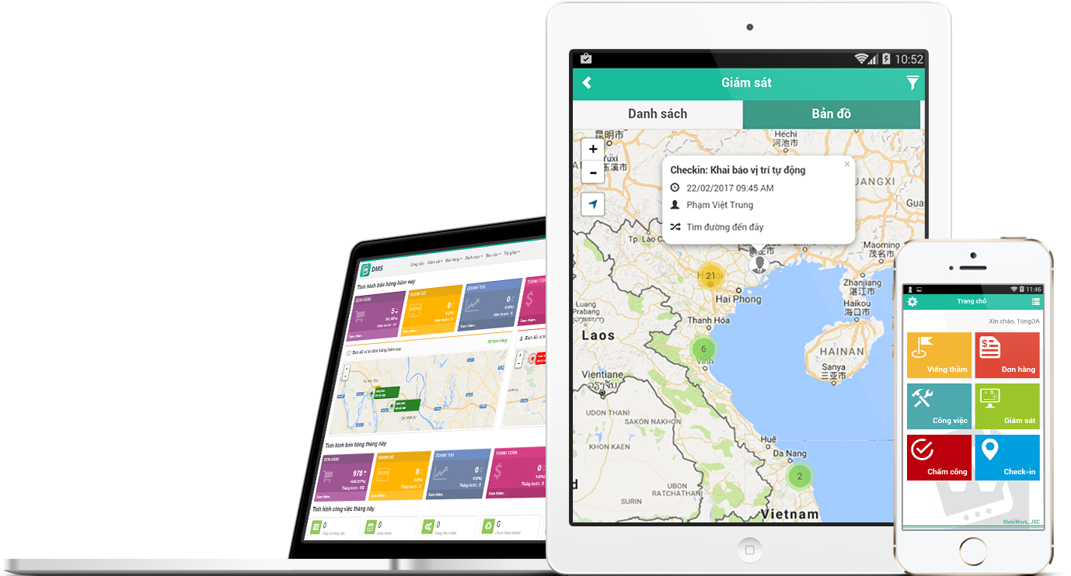
Distributor Management System
User Training
SALES KPI

Slide 3
Agenda
OVERVIEW
SALES KPI LIST
PROCESS
SET UP KPI
REPORTS

Slide 4
I. OVERVIEW
Set up KPIs for tracking performance of Sales team such as Salesman, Sales Supervisor, and Sales Area Manager
Tracking KPI of sales team by monthly
At the end of month, KPIs of sales team will be calculated and shown on KPI report with Target, Achievement, and % Completed information

Slide 5
Agenda
OVERVIEW
SALES KPI LIST
PROCESS
SET UP KPI
REPORTS

Slide 6
II. SALES KPI LIST
No. | KPI | Definition | Formula | Example
1 | Revenue | The total revenue that purchased by customers in a sales cycle | = Sum (Revenue) of Salesman in a month | Total revenue in a month = 300,000,000
2 | Revenue by Product Groups | The total revenue of the product group that was purchased by customers in a sales cycle | = Sum (Revenue by product groups) of Salesman in a month | Total revenue by CAT(Food) = 40,000,000 CAT(Beverage) = 260,000,000
3 | ASO - Active Selling Outlet | The number of outlet that purchase from Salesman in that month | ASO = count distinct (Customer order) in a month %ASO = ASO / MCP | There are 5 customers had purchased in this month in route A → ASO of route A = 5
4 | ASO by Product Group | The number of outlets in a route that has purchased the products group in a sales cycle | ASO by product groups = count distinct (customer order by product groups) in a month %ASO by product groups = ASO by product groups / MCP | There are 5 customers had purchased in this month, but just 4 customer had purchased product group 1 in route A → ASO of route A = 5 → ASO by product groups 1 of route A = 4

Slide 7
II. SALES KPI LIST
No. | KPI | Definition | Formula | Example
5 | Total PC (Productivity Call) | The number of orders in a route had delivered successfully in a sales cycle. Multiple orders of an outlet in same day will be counted as 1. | PC = count distinct (customer order) in a day %PC = PC / Actual visit calls | Today, customer A has 2 orders and Customer B has 1 order → PC is counted as 2 (base on sales order date) Total PC is sum of PC in day of month Actual visit calls = 2 → %PC = 2/2 =100%
6 | LPPC (Line Per Productivity Call) | The average number of SKUs in a PC | LPPC = Total SKU / Total PC | Today, SKU = 3, PC=2 → LPPC= 3/2 = 1,5
7 | %Visited | The number of visits had been conducted in a sales cycle | Visited calls= count distinct (visit customer) in a day %Visited = Visited calls / Actual visited calls | Visited calls in month = 600 Actual visited calls = 780 → %Visited = 600 / 780 * 100% = 77%

Slide 8
Agenda
OVERVIEW
SALES KPI LIST
PROCESS
SET UP KPI
REPORTS

Slide 9
III. PROCESS

Slide 10
Agenda
OVERVIEW
SALES KPI LIST
PROCESS
SET UP KPI
REPORTS

Slide 11
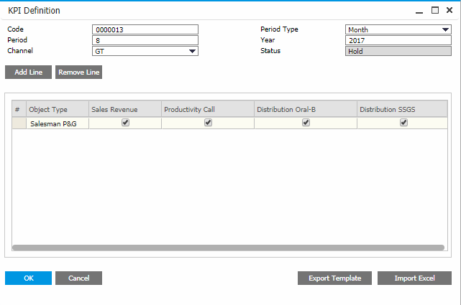
IV. SET UP KPI
1. Define KPI
Step Description
Step1: Ctrl + A then input Channel, Period Type, Month, and Period
Step 2: Select Add Line
Step 3: Select the KPI type which will be included
Step 4: Select Add to save the information
1
2
3
4

Slide 12
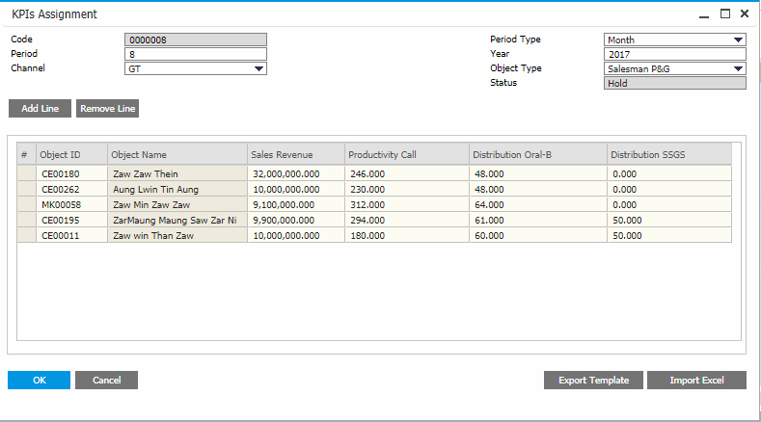
IV. SET UP KPI
2. Assignment KPI
Step Description
Step1: Ctrl + A then input Channel, Period Type, Month, and Period
Step 2: Select Add Line
Step 3: Select the Object ID and assign KPI
Step 4: Select Add to save the information
1
2
3
4

Slide 13
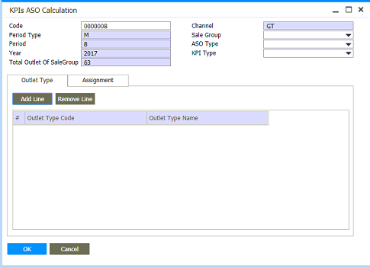
IV. SET UP KPI
3. KPI ASO Calculation
Step Description
Step1: Ctrl + A then input Code, Sales Group, ASO Type, and KPI Type
Step 2: Select tab Outlet Type
Step 3: Select Add Line
Step 4: Select Outlet Type Code
1
2
3
4

Slide 14
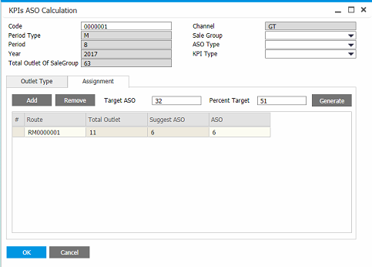
IV. SET UP KPI
3. KPI ASO Calculation
Step Description
Step 5: Select tab Assignment
Step 6: Input Target ASO, and Percent Target
Step 7: Select Generate
Step 8: Select Add to save the information
5
6
7
8

Slide 15
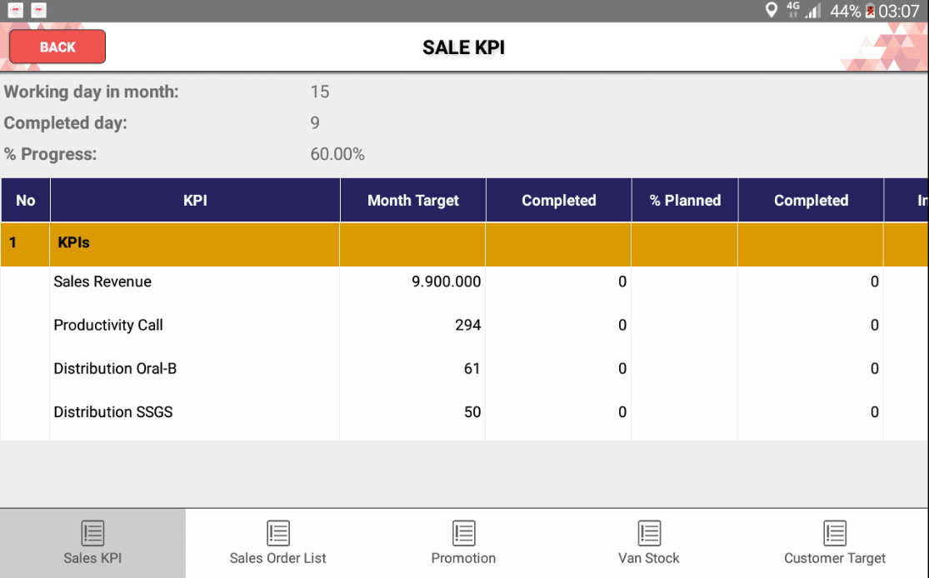
IV. SET UP KPI
4. View KPI in SFA

Slide 16
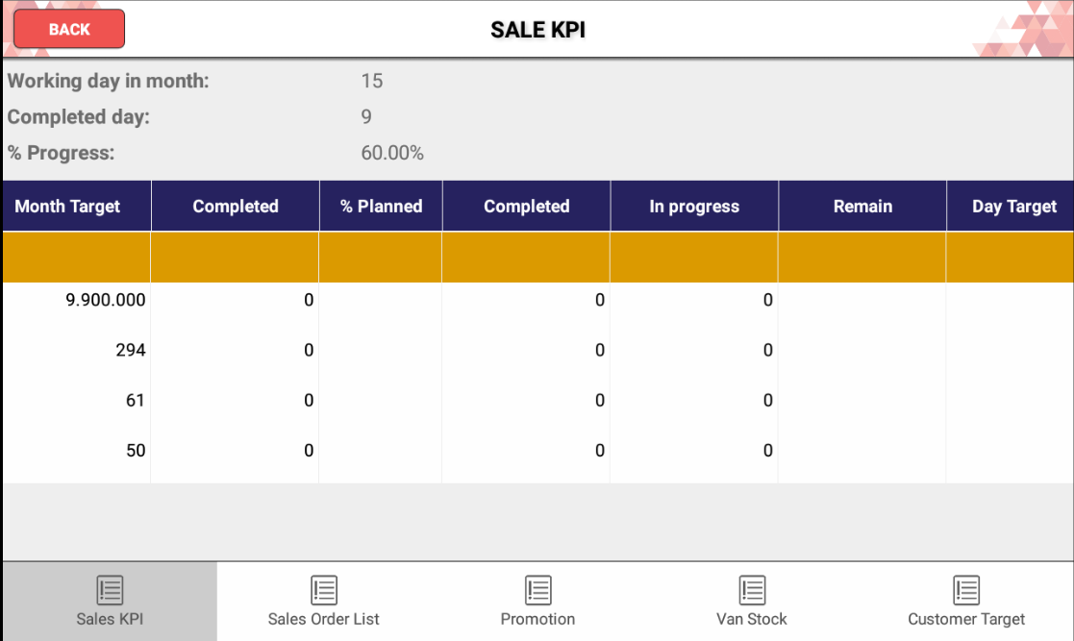
IV. SET UP KPI
4. View KPI in SFA (cont.)

Slide 17
Agenda
OVERVIEW
SALES KPI LIST
PROCESS
SET UP KPI
REPORTS

Slide 18
IV. REPORT
Country | Region | Area | Salesman | KPIs 01 |  |  | KPIs 02
 |  |  |  | Target | Actual | % | Target | Actual | %
Myanmar | North | North 01 | Salesman 01 | 5 | 3 | 60% | 8 | 3 | 38%
 |  |  | Salesman 02 | 12 | 8 | 67% | 12 | 9 | 75%
 |  |  | Salesman 03 | 9 | 4 | 44% | 14 | 4 | 29%
 |  | North 02 | Salesman 04 | 15 | 5 | 33% | 9 | 5 | 56%
 |  |  | Salesman 05 | 20 | 11 | 55% | 26 | 11 | 42%

Slide 19
QUESTION & ANSWER

